Slide 1
Chapter 3
Brands Resonance and the Brand Value Chain
Notes:
If this PowerPoint presentation contains mathematical equations, you may need to check that your computer has the following installed:
1) MathType Plugin
2) Math Player (free versions available)
3) NVDA Reader (free versions available)

Slide 2
Learning Objectives
Define brand resonance
Describe the steps in building brand resonance
Define the brand value chain
Identify the stages in the brand value chain
Contrast brand equity and customer equity

Slide 3
Building A Strong Brand: The Four Steps of Brand Building
Brand Salience
Brand Performance
Brand Imagery
Brand judgments
Brand Feelings
Brand Resonance
Brand-Building Implications
Notes:
Building a strong brand: The four steps of brand building:
Ensure identification of the brand with customers and an association of the brand in customers’ minds with a specific product class, product benefit, or customer need.
Firmly establish the totality of brand meaning in the minds of customers by strategically linking a host of tangible and intangible brand associations.
Elicit the proper customer responses to the brand.
Convert brand responses to create brand resonance and an intense, active loyalty relationship between customers and the brand.

Slide 4
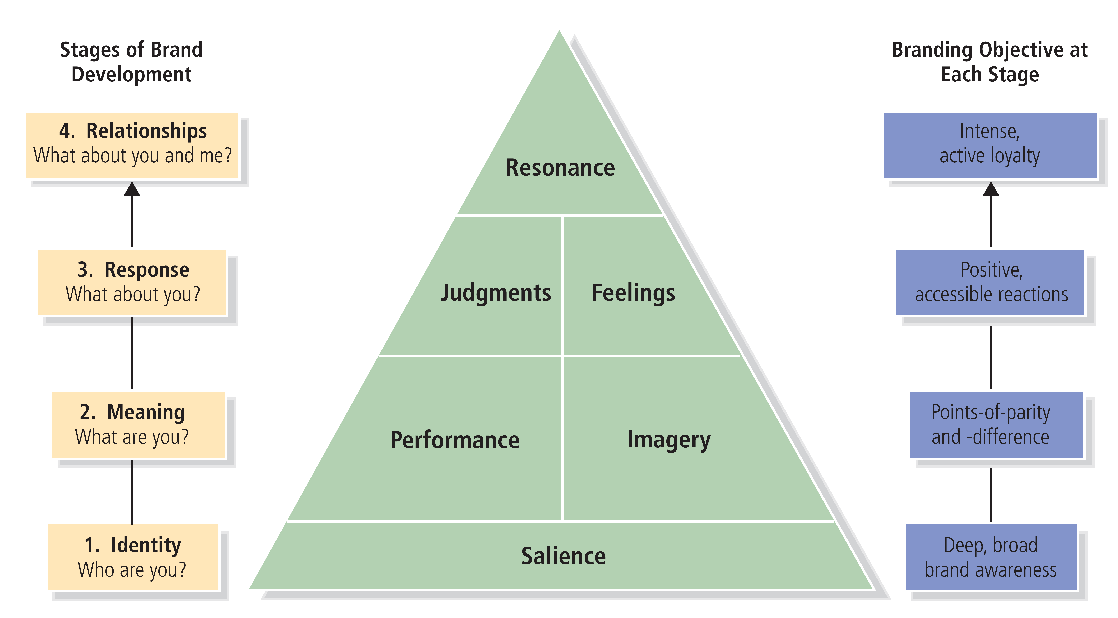
Figure 3-1: Brand Resonance Pyramid

Slide 5
Figure 3-2: Subdimensions of Brand Building Blocks

Slide 6
Brand Salience (1 of 4)
Achieving the right brand identity means creating brand salience with customers
Brand salience:
Measures various aspects of the awareness of the brand
How easily and often the brand is evoked under various situations or circumstances

Slide 7
Brand Salience (2 of 4)
Breadth and depth of awareness:
Gives a product an identity by linking brand elements to:
The product category
The associated purchase
The consumption or usage situations
Notes:
Breadth and depth of awareness:
Breadth—Range of purchase and usage situations in which the brand element comes to mind.
Depth—Ease with which brand elements can be recalled.
Product category structure—How product categories are organized in the consumer’s memory.

Slide 8
Brand Salience (3 of 4)
Product category structure:
How product categories are organized in memory
Marketers assume that products are grouped
Notes:
Product category structure:
How product categories are organized in the consumer’s memory.
The beverage market provides a good setting to examine issues in category structure and the
effects of brand awareness on brand equity. Figure 3-3 (on the next slide) illustrates one hierarchy that might exist in consumers’ minds.

Slide 9
Figure 3-3: Beverage Category Hierarchy
Notes:
Product category structure:
How product categories are organized in the consumer’s memory.

Slide 10
Brand Salience (4 of 4)
Strategic implications:
Brand needs to be top-of-mind and have sufficient mind share:
But also must do so at the right times and places
Notes:
Strategic implications:
Where do consumers think about a brand?
When consumers think of a brand?
How often do consumers think of a brand?

Slide 11
Brand Performance (1 of 2)
Describes how well the product or service:
Meets customers’ more functional needs
Rate on objective assessments of quality
Satisfies utilitarian, aesthetic, and economic customer needs and wants in the product or service category

Slide 12
Brand Performance (2 of 2)
Attributes and benefits often underlie brand performance:
Primary ingredients and supplementary features
Product liability, durability, and serviceability
Service effectiveness, efficiency, and empathy
Style and design
Price
Notes:
Attributes and benefits that underlie brand performance:
Primary ingredients and supplementary features.
Product reliability, durability, and serviceability:
Reliability: Measures the consistency of performance over time and from purchase to purchase.
Durability: The expected economic life of the product.
Serviceability: The ease of repairing the product if needed.
Service effectiveness, efficiency, and empathy:
Effectiveness: Measures how well the brand satisfies customers’ service requirements.
Efficiency: Describes the speed and responsiveness of service.
Empathy: Is the extent to which service providers are seen as trusting, caring, and having the customer’s interests in mind.
Style and design
Price:
Consumers may organize their product category knowledge in terms of the price tiers of different brands.

Slide 13
Brand Imagery (1 of 4)
A main type of brand meaning is brand imagery
Brand imagery depends on the extrinsic properties of a product or service
Many kinds of intangibles can be linked to a brand; the four main ones are:
User profiles
Purchase and usage situations
Personality and values
History, heritage, and user experiences

Slide 14
Brand Imagery (2 of 4)
User imagery:
One set of brand imagery associations is about the type of person or organization who uses the brand
Demographic factors include:
Gender
Age
Race
Income
Purchase and usage imagery:
Associations that tells consumers under what conditions or situations they can or should buy and use a brand
Notes:
User imagery:
Type of person or organization who uses the brand.
Results in customers’ mental image of actual users or more aspirational, idealized users.
Consumers may base associations of a typical or idealized brand user on descriptive demographic factors or more abstract psychographic factors:
Demographic factors: Gender, age, race, and income.
Psychographic factors: Attitudes toward life, careers, possessions, social issues, or political institutions.
Purchase and usage situations/imagery:
Associations that tell consumers under what conditions or situations they can or should buy and use the brand.
Associations to a typical usage situation can relate to the time to use the brand, location, and type of activity during which to use the brand.

Slide 15
Brand Imagery (3 of 4)
Brand personality and values:
Through consumer experience or marketing activities, brands may take on personality traits or human values:
A person
Appear to be modern or old-fashioned, for example
Five dimensions of brand personality:
Sincerity
Excitement
Competence
Sophistication
Ruggedness
Notes:
Brand personality and values:
Through consumer experience or marketing activities, brands may take on personality traits.
Five dimensions of brand personality:
Sincerity (down-to-earth, honest, wholesome, and cheerful)
Excitement (daring, spirited, imaginative, and up-to-date)
Competence (reliable, intelligent, and successful)
Sophistication (upper class and charming)
Ruggedness (outdoorsy and tough)

Slide 16
Brand Imagery (4 of 4)
Brand history, heritage, and experiences:
Brands may take on associations to their past
Certain noteworthy events in the brand’s history
Notes:
Brand history, heritage and experiences:
Brands association with its past and with certain noteworthy events in the brand’s history.
These types of associations may recall distinctly personal experiences and episodes or past behaviors and experiences of friends, family, or others.
They can be highly personal and individual, or more well-known and shared by many people.

Slide 17
Brand Judgments (1 of 4)
Customers’ personal opinions about and evaluations of a brand:
Consumers form judgments by putting together all the different brand performance and imagery associations

Slide 18
Brand Judgments (2 of 4)
Brand quality:
Defined by specific attributes and benefits of a brand
Consumers can hold a host of attitudes toward a brand:
But the most important relate to its perceived quality
Perceived quality measures are inherent in many approaches to brand equity
Notes:
Brand quality:
Specific attributes and benefits of the brand that help develop consumer attitudes toward the brand.
Important consumer attitudes relate to its perceived quality and to customer value and satisfaction.
Perceived quality measures are inherent in many approaches to brand equity.

Slide 19
Brand Judgments (3 of 4)
Brand credibility:
Judgments about the company or organization behind the brand:
Often defined by:
Perceived expertise
Trustworthiness
Likability
Notes:
Brand credibility:
Extent to which customers see the brand as credible in terms of perceived:
Expertise—Competence, innovation, and ability to lead.
Trustworthiness—Dependability and keeping customer interests in mind.
Likability—Fun, interesting, and worth spending time with.

Slide 20
Brand Judgments (4 of 4)
Brand considerations:
Unless a consumer gives serious consideration to purchase, how highly they regard the brand is of little importance
Depends on the extent to which strong and favorable brand associations can be created
Brand superiority:
Measures extent to which customers view the brand as unique:
And better than other brands
Notes:
Brand consideration:
How personally relevant customers find the brand.
Crucial filter in terms of building brand equity.
Brand superiority:
Extent to which customers view the brand as unique and better than other brands.
Critical to building intense and active relationships with customers.
Depends to a great degree on the number and nature of unique brand associations that make up the brand image.

Slide 21
Brand Feelings (1 of 2)
Customers’ emotional responses and reactions to a brand
Brand feelings relate to the social currency evoked by the brand
Feelings can be:
Experiential and immediate, increasing in level of intensity
Private and enduring, increasing in level of gravity

Slide 22
Brand Feelings (2 of 2)
Six important types of brand-building feelings:
Warmth
Fun
Excitement
Security
Social approval
Self-respect
Notes:
Important brand building feelings:
Warmth—Soothing feelings that make consumers feel a sense of calm or peacefulness.
Fun—Upbeat feelings that make consumers feel amused, lighthearted, joyous, playful, and cheerful.
Excitement—Ability of the brand to make consumers feel energized and experience something special.
Security—Ability of a brand to produce a feeling of safety, comfort, and self-assurance.
Social approval—Gives consumers a belief that others look favorably on their appearance and behavior.
Self-respect—Brand makes consumers feel better about themselves.
The first three types of feelings are experiential and immediate, increasing in level of intensity.

Slide 23
Brand Resonance (1 of 3)
Ultimate relationship and level of identification that a customer has with a brand:
Describes the nature of the relationship
Extent to which customers feel in sync with the brand
Characterized in terms of intensity:
Depth of the psychological bond that customers have with a brand
Four categories of brand resonance:
Behavioral loyalty
Attitudinal attachment
Sense of community
Active engagement

Slide 24
Brand Resonance (2 of 3)
Behavioral loyalty:
Repeat purchases and the amount or share of category volume attributed to the brand:
Share of category requirements
Attitudinal attachment:
Resonance requires a strong personal attachment
Going beyond having a positive attitude:
Viewing the brand as something special
Notes:
Behavioral loyalty:
Gauged in terms of repeat purchases and the share of category volume attributed to the brand.
Attitudinal attachment:
Strong personal attachment with product.

Slide 25
Brand Resonance (3 of 3)
Sense of community:
Brand may take on a broader meaning by conveying a sense of community
Social phenomenon in which customers feel a kinship or affiliation with others associated with the brand
Active engagement:
Perhaps the strongest affirmation of brand loyalty
Willing to invest time, energy, money, or other resources beyond those expended during purchase or consumption
Notes:
Sense of community:
Sense of affiliation with other people associated with the brand.
Active engagement:
The strongest affirmation of brand loyalty occurs when customers are engaged, or willing to invest time, energy, money, or other resources in the brand beyond those expended during purchase or consumption of the brand.

Slide 26
Brand-Building Implications
Marketers can assess their brand’s progress in their brand-building efforts through the brand resonance model:
Customers own the brand
Don’t take shortcuts with brands
Brands should have a duality
Brands should have richness
Brand resonance provides important focus
Customer networks strengthen brand resonance
Notes:
See Figure 3-4 for details of each level of the model.

Slide 27
The Brand Value Chain
Structured approach to:
Assessing the sources and outcomes of brand equity and the manner by which marketing activities create brand value

Slide 28
Figure 3-5: Brand Value Chain
Notes:
Brand value chain—Implications:
Value creation begins with the marketing program investment.
Value creation requires more than the initial marketing investment.
Provides a detailed road map for tracking value creation that can make marketing research and intelligence efforts easier.

Slide 29
The Brand Value Stages (1 of 6)
Marketing program investment:
Any marketing program investment that can contribute to brand value development:
Intentional or not
Program quality multiplier:
D R I V E:
Distinctiveness
Relevance
Integrated
Value
Excellence

Slide 30
The Brand Value Stages (2 of 6)
Customer mind-set:
Includes everything that exists in the minds of customers with respect to brand:
Brand awareness
Brand associations
Brand attitudes
Brand attachment
Brand activity

Slide 31
The Brand Value Stages (3 of 6)
Marketplace conditions multiplier:
Extent to which value created depends on factors beyond the individual customer:
Competitive superiority
Channel and other intermediary support
Customer size and profile

Slide 32
The Brand Value Stages (4 of 6)
Market performance:
Price premiums
Price elasticities
Market share
Brand expansion
Cost structure; reduced marketing program expenditures
Brand profitability

Slide 33
The Brand Value Stages (5 of 6)
Investor sentiment multiplier:
Financial analysts and investors arrive at their brand valuations and investment decisions through the following:
Market dynamics
Growth potential
Risk profile
Brand contribution
Shareholder value:
Financial marketplace formulates opinions and assessments
Direct financial implications for brand value

Slide 34
The Brand Value Stages (6 of 6)
The brand value chain has numerous implications:
Value creation begins with the marketing program investment
Value creation requires more than an initial marketing investment
Band value chain provides a detailed road map for tracking value creation

Slide 35
Brand Community
Airbnb’s consistent rebrand focuses on the sense of belonging to a community | The Branding Journal

